Slide 1

Free Project - HoloTek
Louis VENTRE – {EPITECH.} 2019
Notes:
Hello,
My name is Louis. I’m a 5th year student in Computer Science at EPITECH

Slide 2

The Idea
Notes:
The main idea behind this project is to improve my knowledge in DirectX and UWP development, while creating something usefull at the same time

Slide 3
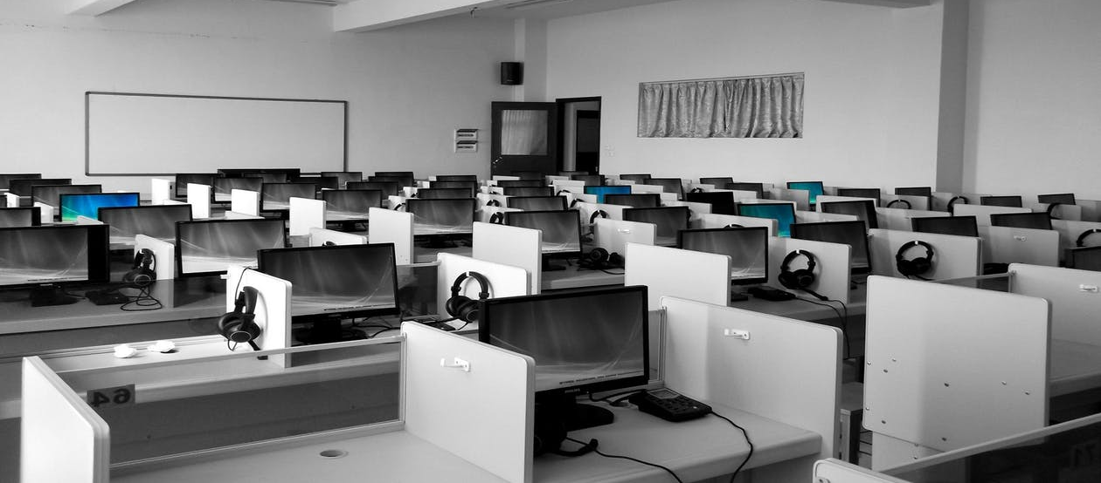
Student’s activities
Notes:
Right now presence of the students at activities is done by NFC using the eToken application.
It takes time, and if you’re not paying attention a student can use the NFC card of one of his colleague (an absent one…)

Slide 4
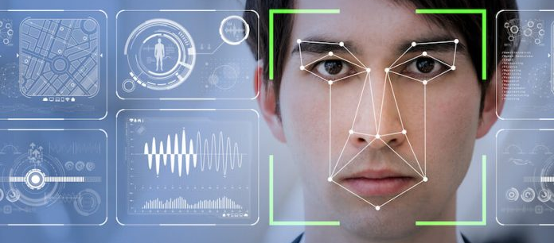
Presence by Facial Recognition
Notes:
Linked to the intranet, the application would be able to detect school students using facial recognition technology

Slide 5

Student’s information
Notes:
We would also access various information like the current GPA, promotion, city, etc. of the student

Slide 6
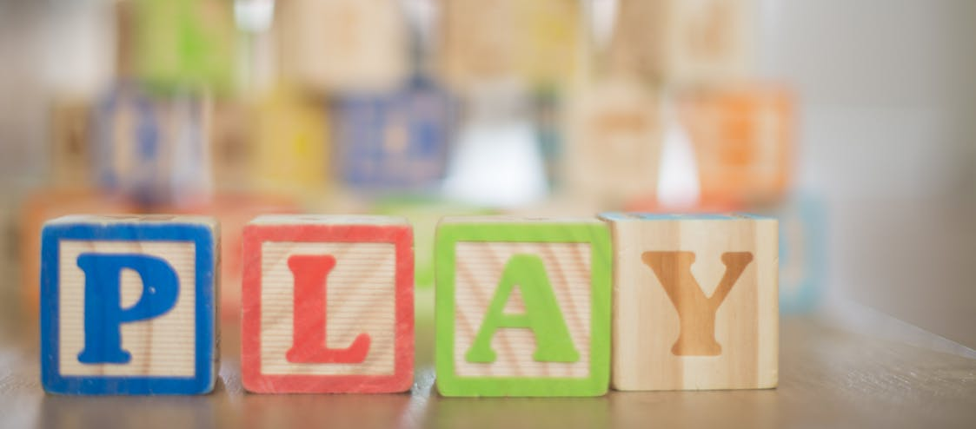
Fun stuff
Notes:
And some fun stuff like lying detector and physical information (hair color, etc.)

Slide 7
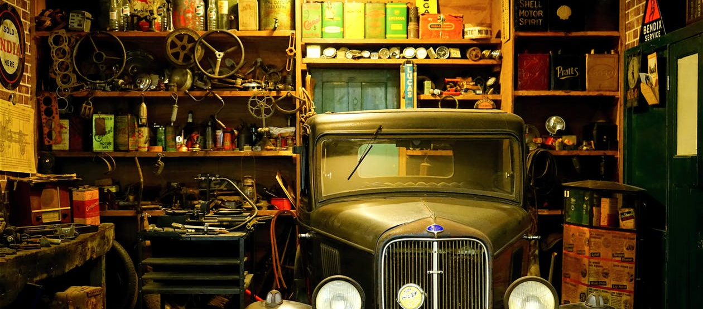
Hub projects
Notes:
Another part of the app, for students, would recognize Hub Project via object recognition

Slide 8
Project’s information
Notes:
In this case too you would be able to get informations about the project: creators, description, released date, etc.

Slide 9

Interactions
Notes:
You will be able to interact with this projects, using speech recognition

Slide 10

Example: Door project
Notes:
If we take a simple project as an example: a robot arm that open or close a door.
Using HoloTek you would be able to open the door only by looking at it and saying « open ».

Slide 11

Web interface
Notes:
All this would be easily configurable using a web interface: adding new projects, new descriptions, new actions.

Slide 12
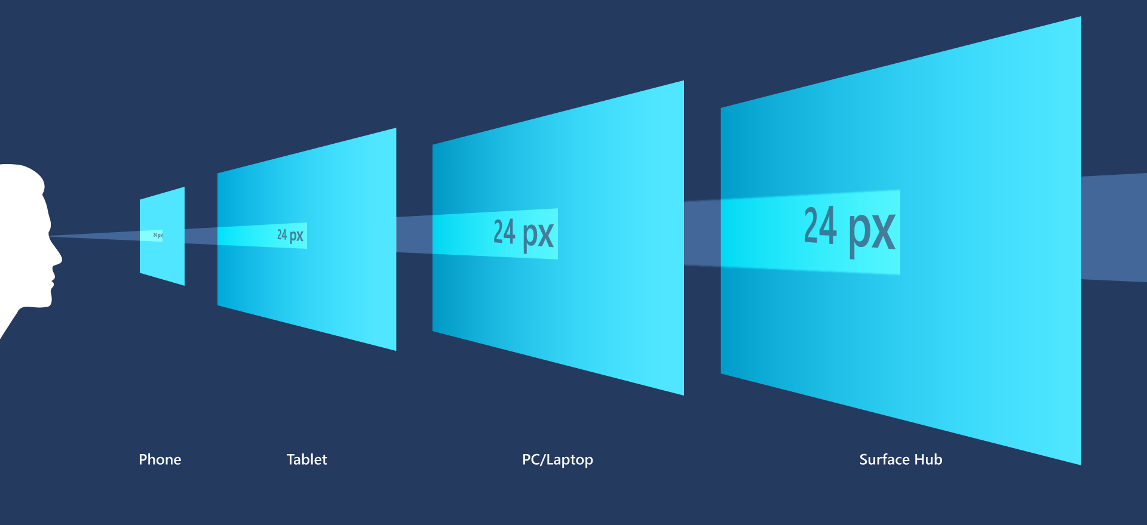
UWP Application
Notes:
Application would be in UWP: cross platform

Slide 13
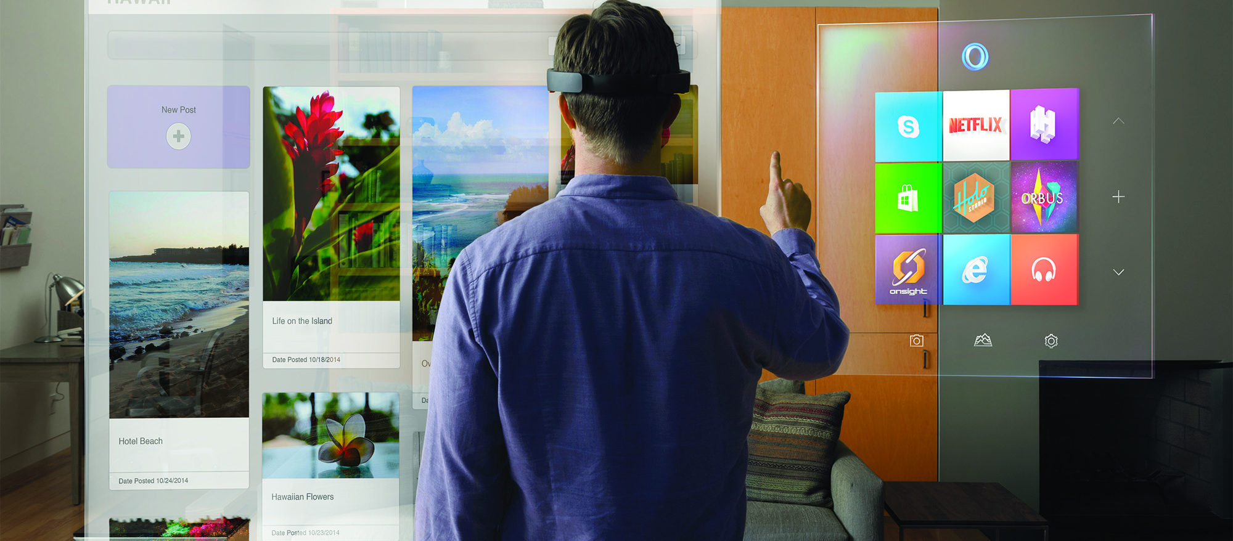
Mixed Reality
Notes:
And HoloLens ready

Slide 14



Technologies
Notes:
Using modern technologies

Slide 15

From a blank page
Notes:
The aim is to do most of it by myself

Slide 16

Questions ?
Notes:
The aim is to do most of it by myself

